Slide 1
WGST 100-L01: Introduction to Women’s and Gender Studies
Week 8: Wednesday, Oct. 24/18
Gendered Identities: Culture of Masculinity and Femininity

Slide 2
Our Conception of Gender
Gender Identity: a person’s sense of their self as a gendered person.
Once considered to be a relatively stable property of all individuals, gender identity is now seen by many as a relational, situational, and fluid quality that intersects with other identities that shape the self.
In short, very subjective and liable to be different relative to the individual

Slide 3
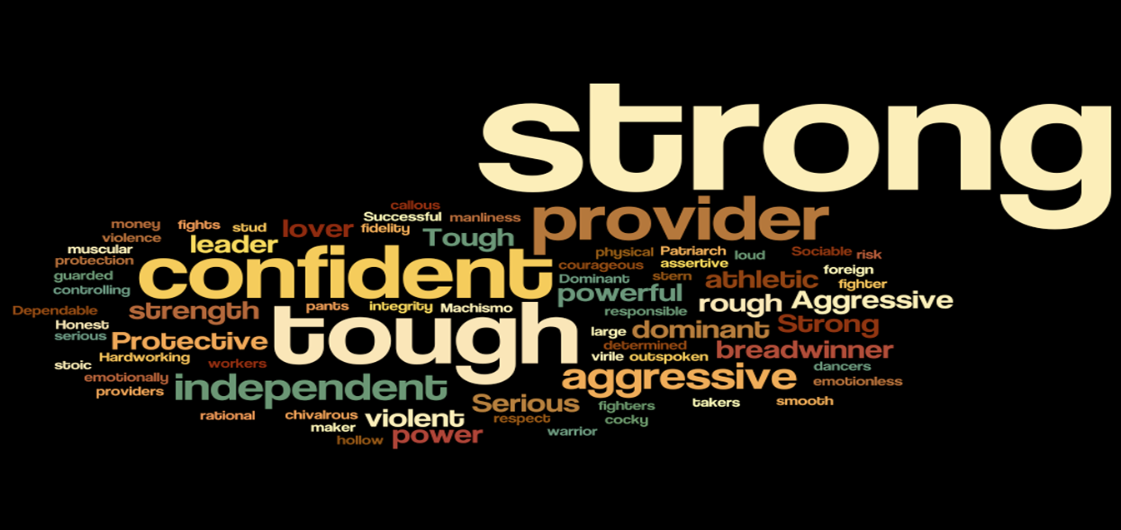
Conception of Masculinity

Slide 4
Conception of Masculinity
While there are multiple ways to be masculine, society still tends to measure men according to certain normative expectations.
In Western Society, masculine ideals include the following qualities:
Competition, Success, Achievement: the act of striving to do ones best and outperforming others if possible.
Self reliance, Assertiveness, Strength, Toughness: pressure to act in control in any situation, to solve problems and to fight for what is right, defending against those who challenge their position, not showing weakness or emotion (or other qualities deemed feminine).

Slide 5
Conception of Masculinity
Not all versions of masculinity are equal.
Some types are clearly more socially desirable.
Hegemonic Masculinity: Dominant form of masculinity that oppresses those of any gender who don’t conform to its standard.
In western society these generally white, middle/upper class, heterosexual and Christian men.

Slide 6

Hegemonic Masculine

Slide 7
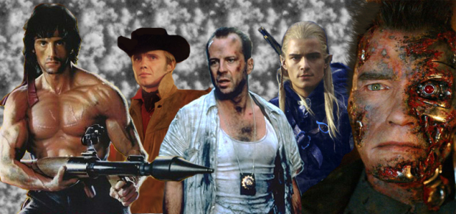
Hegemonic Masculine

Slide 8
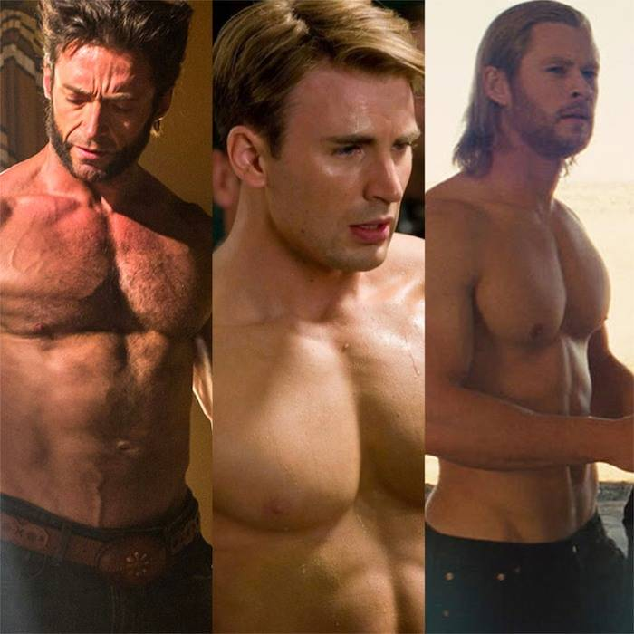
Hegemonic Masculine

Slide 9
Hegemonic Masculine
The common thread in these expectations is performance: men’s masculinity is judged by performance.
They are also culturally specific.
Furthermore, they change over time and place, depending on the needs and features of a particular culture.

Slide 10
Masculinity: Negative Outcomes
Men compete and continually prove their manhood which leads to aggressive and exploitative attitudes that erode relationships.
Success: Men are trapped in the harness of working to provide (making as much money as possible) and come to see everything as a potential customer, always trying to sell or profit from relationships, often forgoing opportunities for other intimate relationships.
Power: Men gain power (the ability to be dominant, to control or coerce) through success in attaining the masculine ideal which requires intense pressure and sacrifice. Those that do not achieve this power (the vast majority) end up feeling angry and frustrated in their powerlessness.

Slide 11
Masculinity: Catastrophic Outcomes
The result of this negative pressure contributes to several harmful trends:
Going to extremes to gain power and prestige (steroids, destructive eating patterns, illegal activities)
A lack of intimate relationships which can isolate the mans from the very society he wishes to dominate
Increased desperation, depression, or psychosis leading to acts of violence towards the self and others

Slide 12
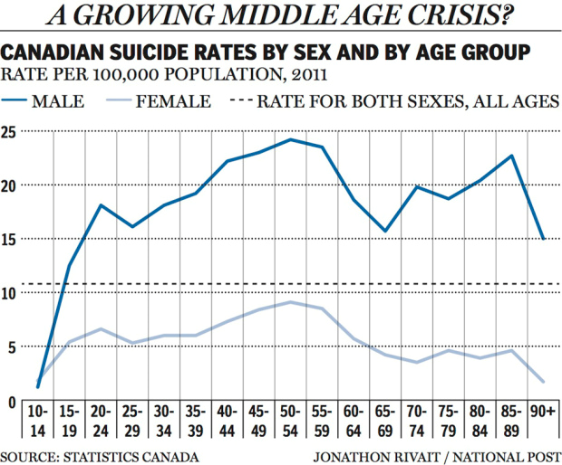
Masculinity: Catastrophic Outcomes

Slide 13
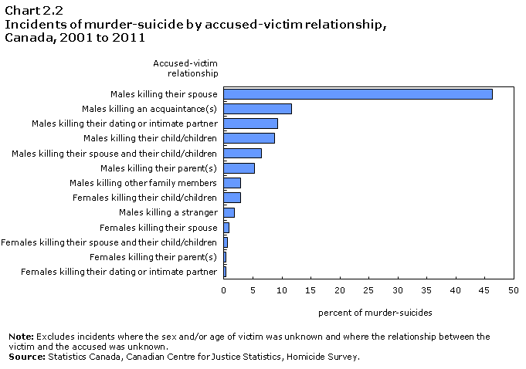
Masculinity: Catastrophic Outcomes

Slide 14
Femininity: Qualities
Femininity: Term used to describe the qualities of women.
The common acceptance of the notion of femininity has been challenged by women’s movements for several decades.
However, typically there are two prominent sets of expectations:
Nurturance, Empathy, and Interdependence: women are expected to express care and concern for others, often putting the needs of others ahead of their own, and are expected to be relationship orientated
Appearance: women are expected to be concerned about their appearance, especially beauty and slenderness

Slide 15
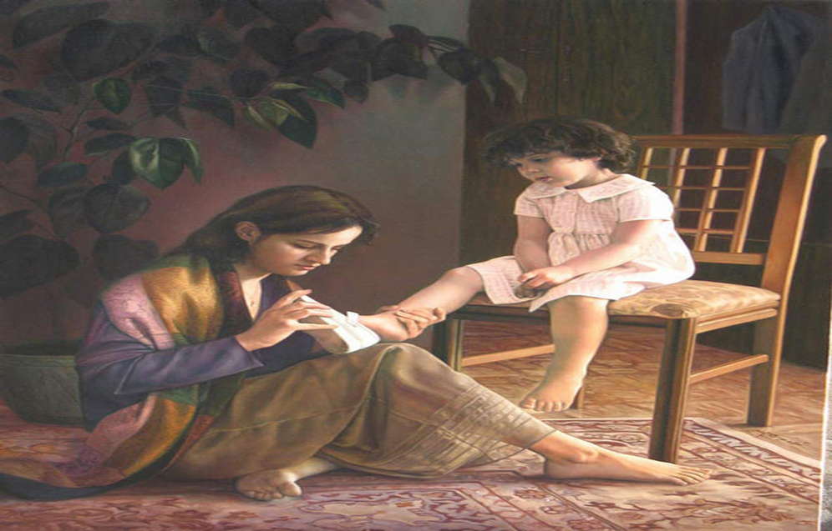
Femininity: The Ideal

Slide 16
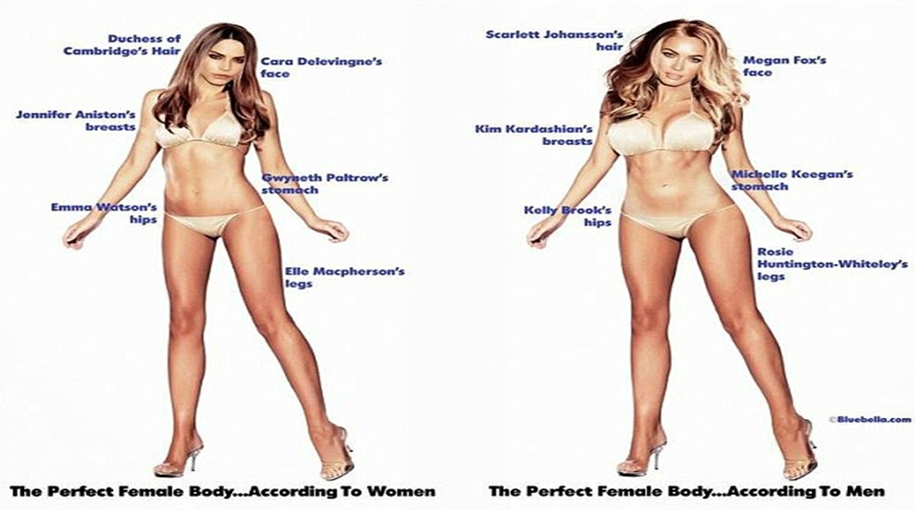
Femininity: Qualities According to Women and Men

Slide 17
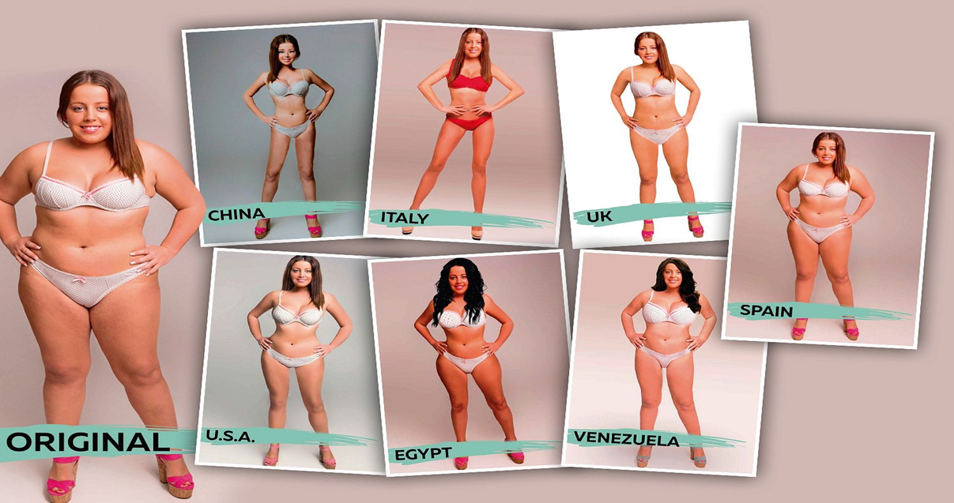
Culture of Femininity: The Ideal According to Countries

Slide 18
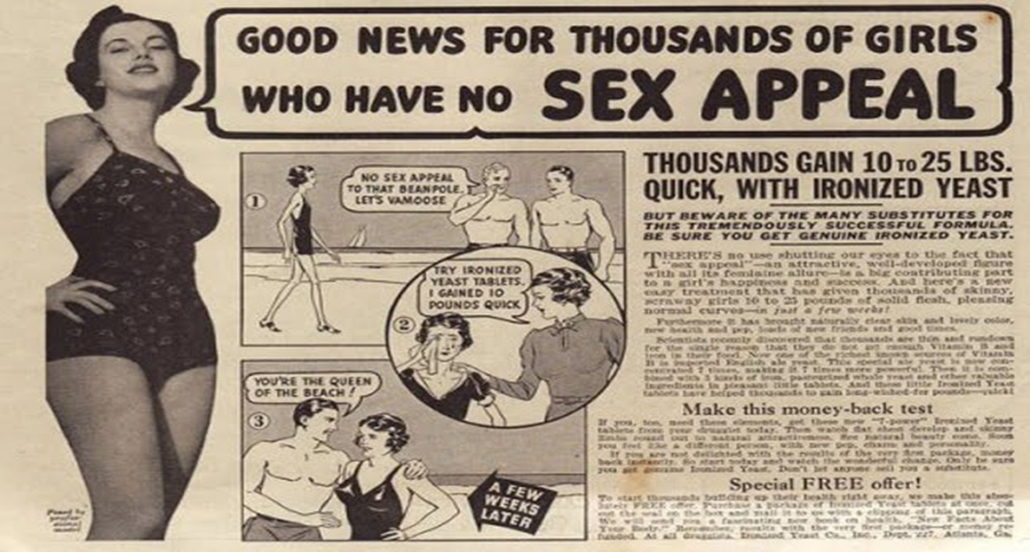
Culture of Femininity: The Ideal in Ads

Slide 19
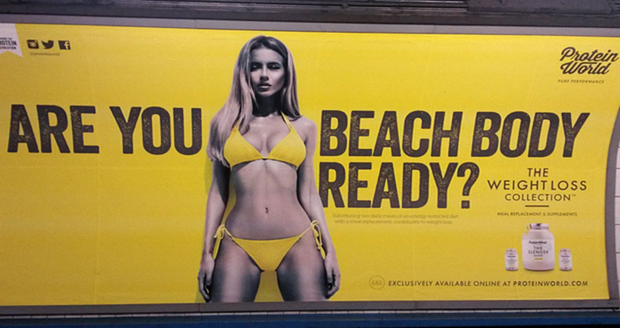
Culture of Femininity: The Ideal in Ads

Slide 20
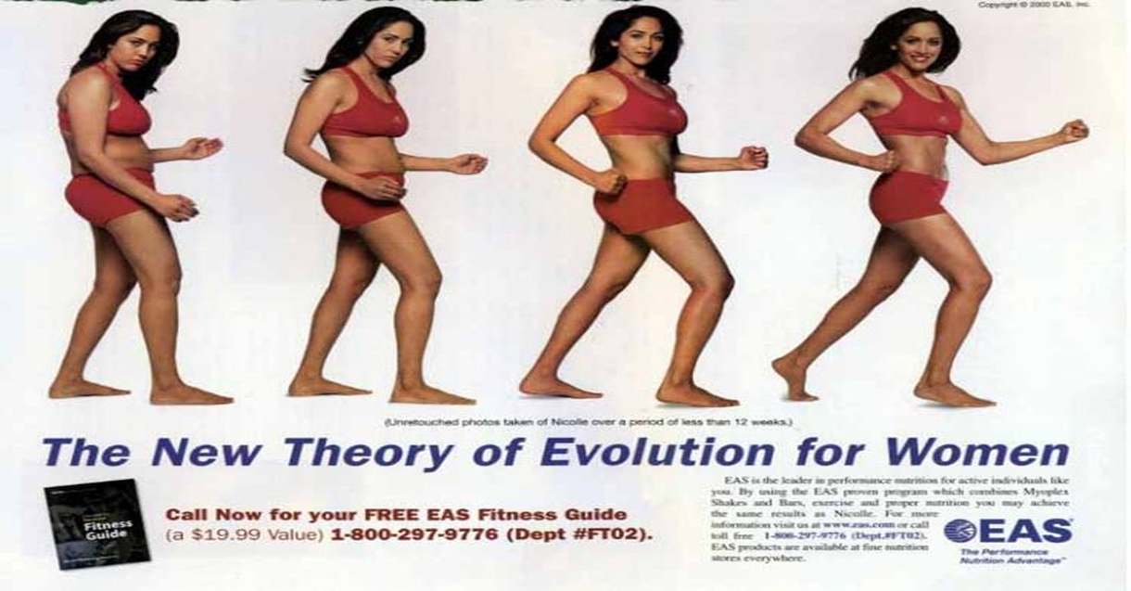
Culture of Femininity: The Ideal in Ads

Slide 21

Culture of Femininity: The Ideal in Ads

Slide 22
Femininity-Negative Outcomes
Ceding Power: By focusing primarily on the needs of others women cede power, decision-making, and the majority of control over their lives to men who, in turn, may not be looking out explicitly for their best interests.
Distorted Image: Image becomes not just an ideal but an obsession.
Women can suffer from internalized oppression where they discipline their bodies to achieve the emphasized ideal, regardless of the costs.

Slide 23
Femininity-Catastrophic Outcomes
The result can contribute to several harmful trends:
Social inequality at work, in the family, and even in all relationships which leads to an underclass of over half the population
Increased health problems as women try to attain the perfect appearance that does not really exist (beauty myth)
Increased isolation, depression, and even psychosis that can lead to self inflicted wounds or even suicide

Slide 24
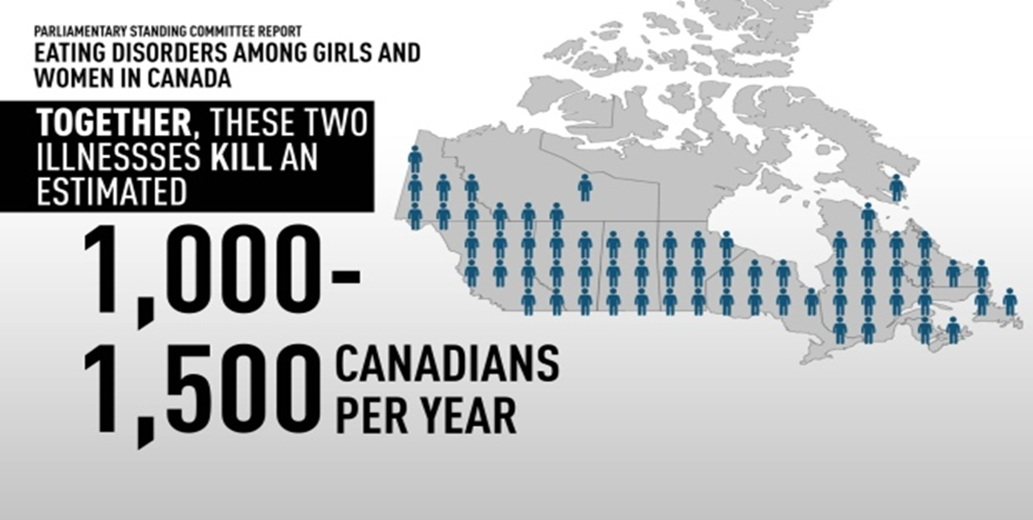
Femininity-Catastrophic Outcomes: Eating Disorders

Slide 25
Femininity: Across Societies- An Overall View
Ultimately what we think we can do and what are off limits are culturally relative.
Documentary: BBC. “What Stands in the Way of Women Being Equal to Men?
https://www.youtube.com/watch?v=ayj9EVc2ZLI

